Slide 1

Hate detection by NLP and deep learning methods
Presented By: Rami Abulfadl
Advisor: Isabel Segura-Bedmar
Masters in Big Data | September 2020

Slide 2
Content
Definition and Motivation
Objectives
Approach: dataset and methods
Evaluation
Conclusions and Future work

Slide 3

What is hate?
“any kind of communication that attacks or uses discriminatory language to a person or a group on the basis of who they are, in other words, based on their religion, ethnicity, nationality, race, colour, descent, gender or other identity factor. ”
UNITED NATIONS STRATEGY AND PLAN OF ACTION ON HATE SPEECH
Notes:
Before beginning let's first start by defining hate. It´s any…..
Hate speech online is situated at the meeting point between many tensions; it is an example of how highly influential technologies such as the Internet bring with them both opportunities and challenges while maintain the complex balancing between fundamental rights and principles, including freedom of expression and the defense of human dignity. Despite being definied by many organization as UN, there is no generic definition of hate, for example, in the United States, much of what falls under the category of "hate speech" is constitutionally protected unlike other european countries.

Slide 4
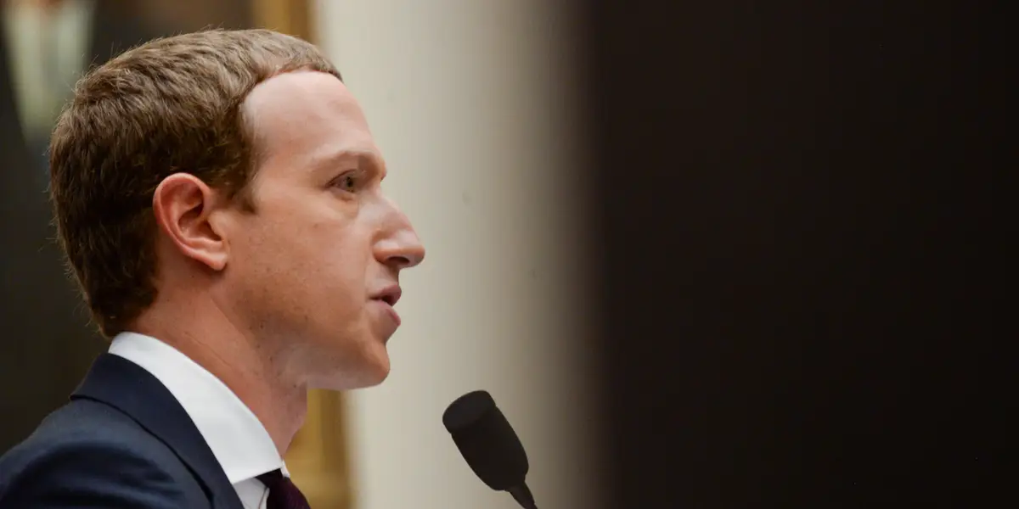
why is it important to detect ?
Facebook engineers quit in protest, accusing the company of 'profiting off hate'
“When the looting starts, the shooting starts” Donald J. Trump
Notes:
Following to the importance of hate detection, this month, facebook software engineer quit in protest after mark zuckerberg refused to remove Donald Trump´s post about some black people stealing from shops during Blach lives matter protesting, which clearly gives the green lights for people to use guns protecting their shops instead of the state. Days after that, Facebook failed to remove a Facebook event, which leads to black protest shooting in the USA. Accordingly, facebook has gained bad publicity

Slide 5
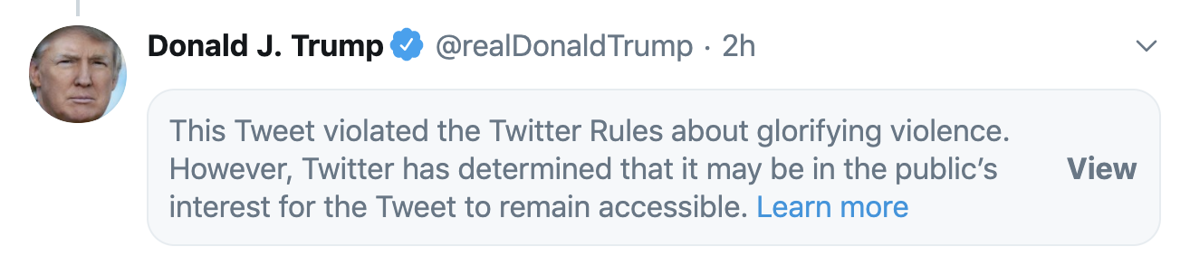
why is it important to detect ?
Remove abusive content for a good cause.
Business reputation
Notes:
Therefore, its important to remove hateful content to protect the lives and dignity of people for a good cause.
As an example, twitter founder Jack Dorsey, had put glorifying violence tag on the tweet despite the huge pressure put on by the white house´s influence. Accordingly, the twitter build a positive reputation in the market, which lead to business growth as more users want to use twitter and more business wants to advertise on twitter.

Slide 6
Objectives
Acquire
the basic knowledge in the field of NLP and deep learning
Analyse
the progression of methods and techniques till reaching the state of art performance in hate detection.
Architect
two most advanced deep learning models, BERT and Bi-LSTM, for hate detection using Twitter dataset.
Assess
The performance of models through error analysis.
Notes:
moving to the objectives of the project, which consists of 4 As. Acquire…...Assess.

Slide 7

Approach: Twitter dataset
Train: 80%
32k tweets
Validation: 10%
Test: 10%
Neutral
Hate
2,242
29,720
Davidson et al.: Automated Hate Speech Detection and the Problem of Offensive Language
Notes:
Lets begin the approach by introducing the dataset used consists of 32 thousand tweets gathered from twitter over a specific period of time identified by internet users as hate speech, compiled by Hatebase.org, which was then labelled by CrowdFlower (CF) annotators.the dataset have been split into 3 partitions train 80, validation 10 and test 10%. The hate tweets class are 2,242 tweets,while the non hate ones are 29,720, which shows the imbalance between classes. This imbalance will be fixed by modified the class weights of the models, which will be the next topic.

Slide 8
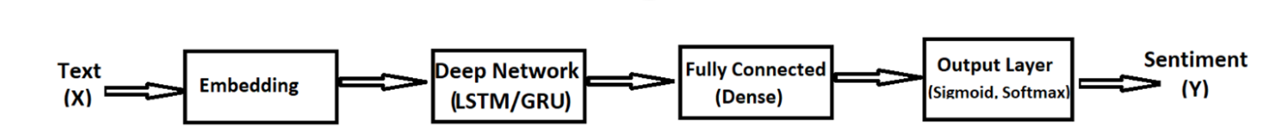
First Approach
Bi-LSTM
Notes:
After pre-processing, First approach is classifiers trained based on the Bidirectional LSTM neural network.let have a quick overview about the model before explaining it thoroughly along the presentation. Firstly, the tweets are tokenized, which means spitting them into words while removing punctuations as hashtags and usernames then converting them into lower case. The tokens then pass to the embedding layer, which represent tokens to a mapped vectors of real numbers. After that, information pass through BI-LSTM layer composed of 128 units. Then, infomation pass into two Fully connected layers, which are responsible for further feature extraction by compiling it, which is composed of 40 and 20 units respectively. Finally, an output sigmoid layer is the final layer to classify the tweet into 1 meaning hateful or 0 meaning neutral.

Slide 9
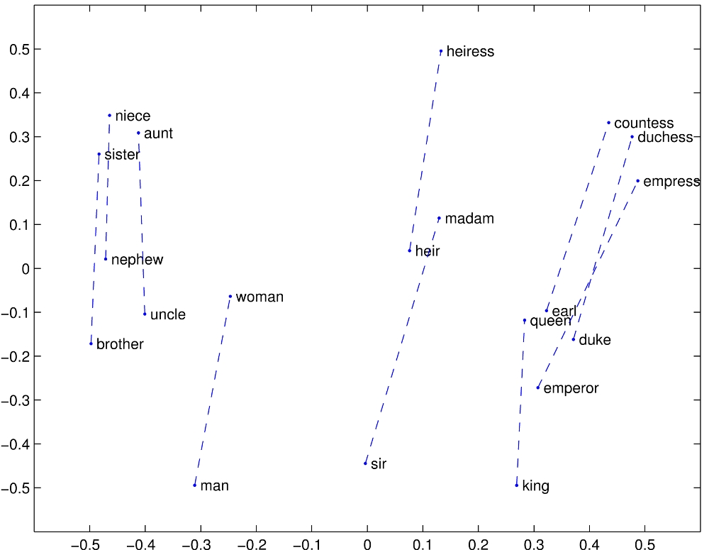
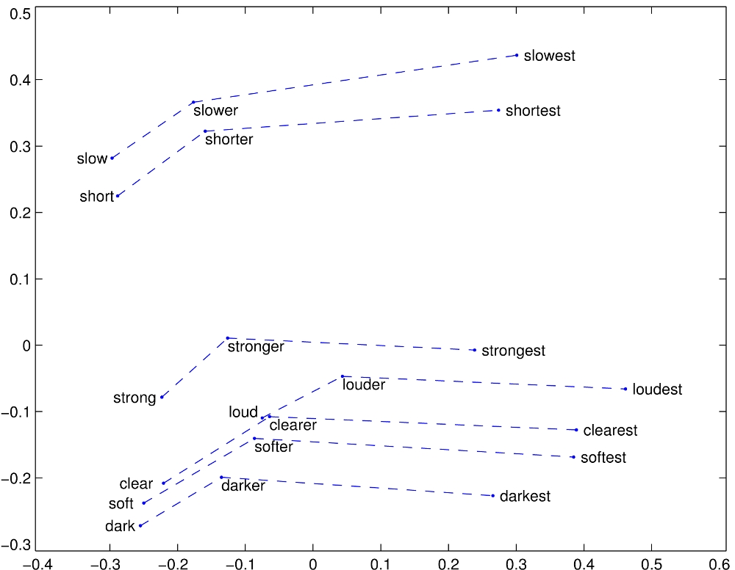
Bi-LSTM
Word Embedding by GloVe for vector space representations
glove.6B.100d 6 B tokens of 400 k vocab forming a 100 dimension form Wikipedia 2014 and Gigaword 5 corpora
Pennington, J., Socher, R., & Manning, C. D. (2014, October). Glove: Global vectors for word representation. In Proceedings of the 2014 conference on empirical methods in natural language processing (EMNLP) (pp. 1532-1543).
Notes:
For word embedding, glove pre-trained word vectors glove.6B.100d, which contains 6 B tokens of 400 k vocab forming a 100 dimension vector representation gathered form Wikipedia 2014 and Gigaword 5 corpora. The vector space representation can be simulated in the photos where words are represented with vectors form 2 dimension, and these vectors are able to capture semantic relationships between words (and then you can explain these pictures).Words are then represented into a matrix using the glove pre trained file, which act as a lookup table. The glove representation is based upon an actual probability of occurrence of words together

Slide 10

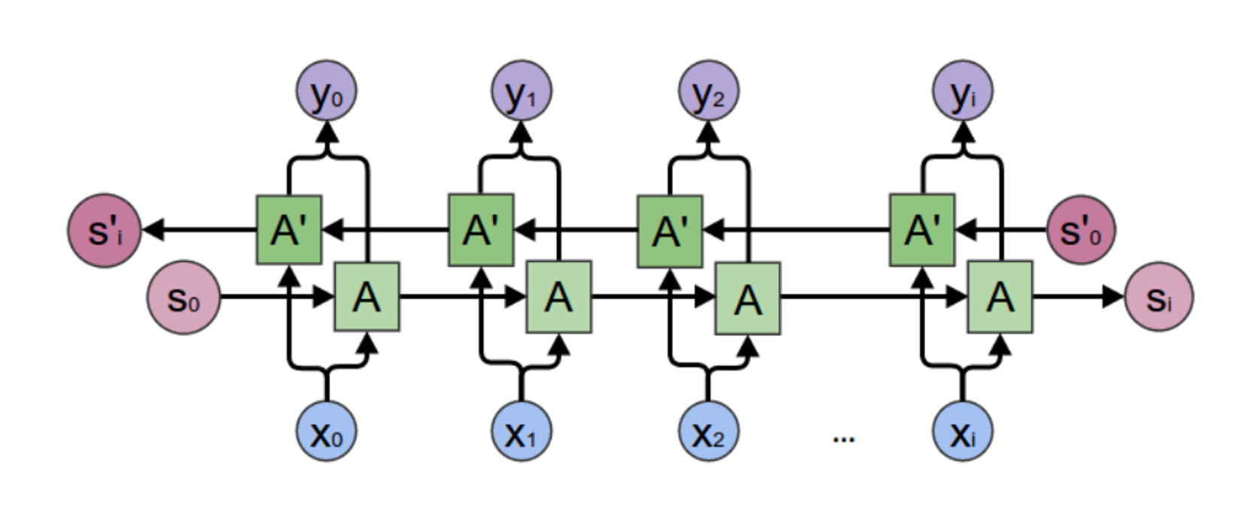
Bi-LSTM

Slide 11
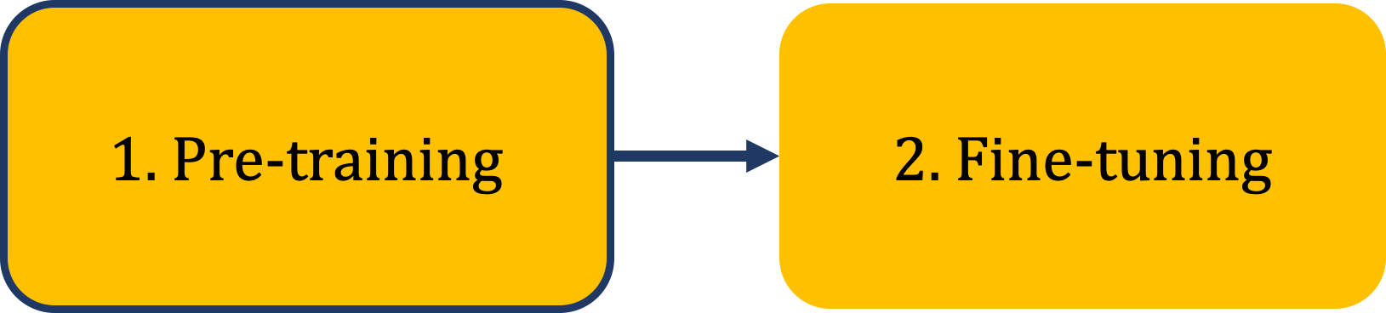
Second Approach
BERT

Slide 12
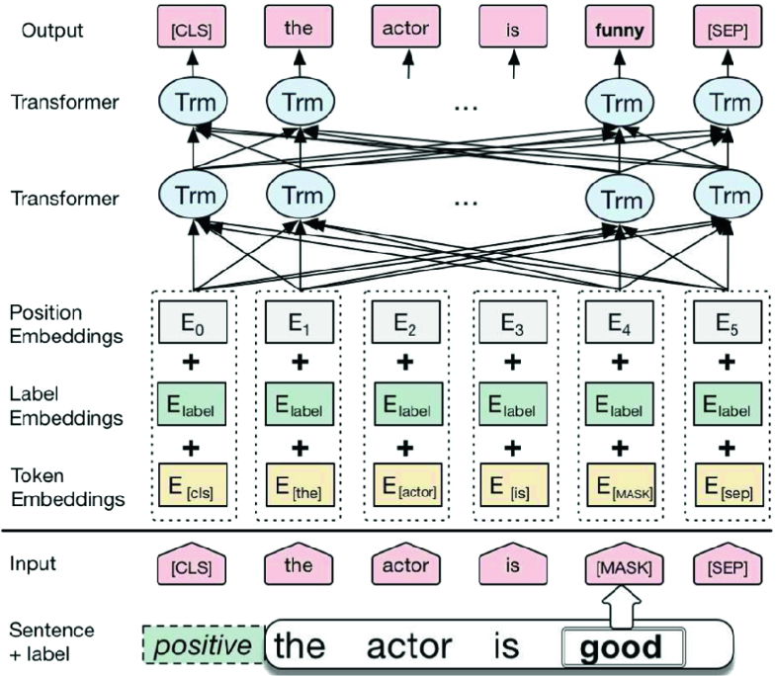
BERT
Wu X., Lv S., Zang L., Han J., Hu S. (2019) Conditional BERT Contextual Augmentation. In: Rodrigues J. et al. (eds) Computational Science – ICCS 2019. ICCS 2019. Lecture Notes in Computer Science, vol 11539. Springer, Cham. https://doi.org/10.1007/978-3-030-22747-0_7
Notes:
YOu should say that this is your second approach. Please, add the reference for BERT.

Slide 13
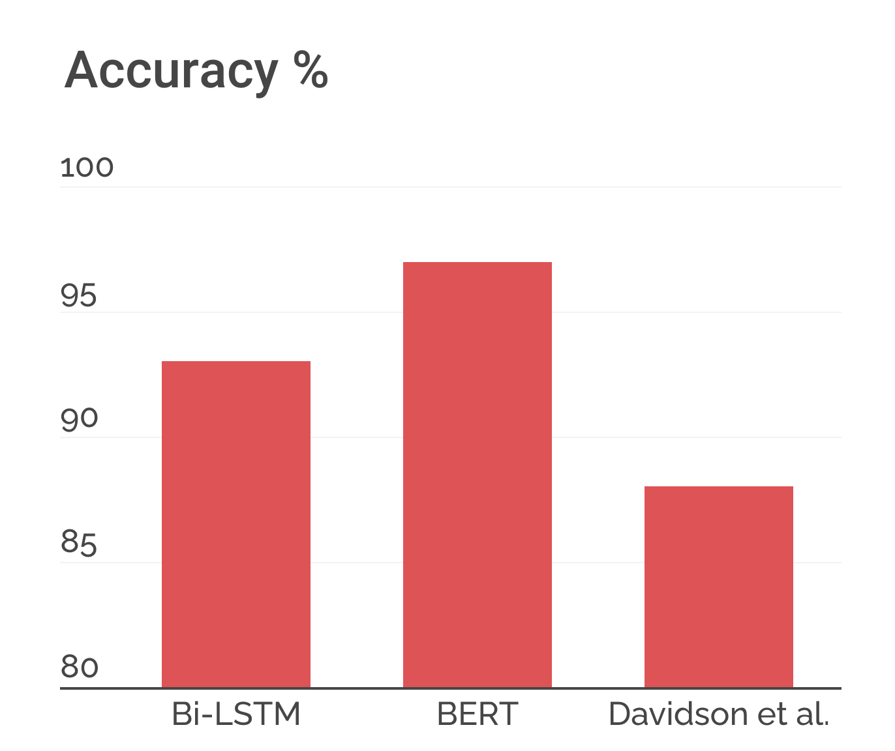
Evaluation
FI-Score
0.7
0.6
97.4 %
93.6 %
BERT
Bi-LSTM
88.7 %
Notes:
Please, add the number of the accuracy for each approach.
Your numbers should have two decimals
I think that for F1-Score, you should also use a bar chat.

Slide 14
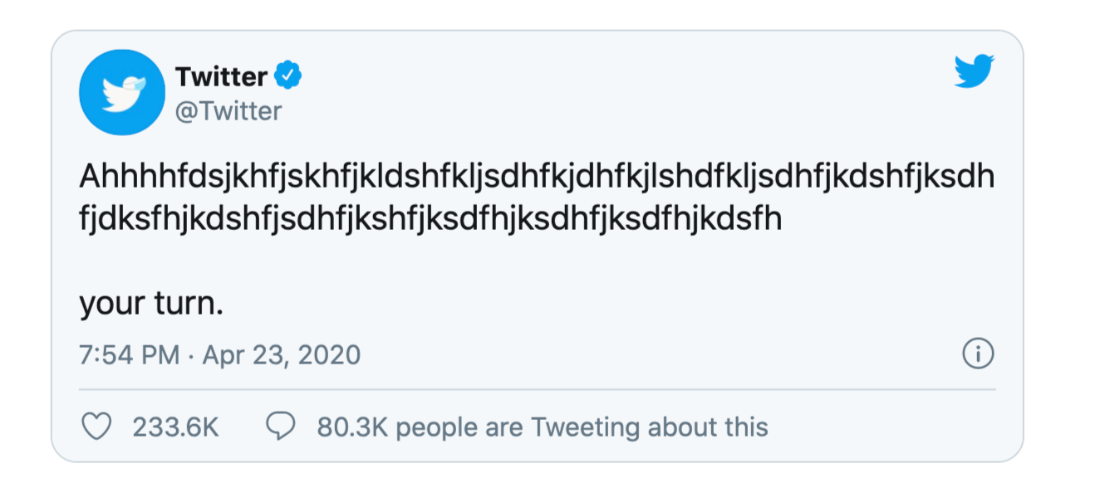
Error Analysis
False positive by LSTM, but True negative by BERT
trump campaign: female judges could be biased, too he must hate women
Notes:
Lstm was wrong
Was BERT right?. Then, you should add this information in the slide (False positive for LSTM, but True positive for BERT)
You should give some possible cause of this FN.

Slide 15
Error Analysis
False negatives by BERT but True positive by LSTM
al capone was jailed for tax evasion, not murders he committed. what is @user 's achilles heel? #unpresidented #nohate
Notes:
Bert was wrong
Was BERT right?. Then, you should add this information in the slide (False positive for LSTM, but True positive for BERT)
Or maybe, both approaches were wrong. Please, tell it in the slide.
You should give some possible cause of this FN.

Slide 16
Conclusions
BERT achieve the best performance in classification.
Both Models get higher accuracy than original davidson et al. results.
Both Models were able to handle unbalanced classes better.

Slide 17



Future Work
odio
Big dataset for training.
Develop better word Embedding for slang words and abbreviations
Cross lingual unified model for non english languages
Notes:
YOu should include a slide for conclusion. For example,
BERT achieves the best results.
Your two approaches (BiLSTM and BERT) overcome previous work (Davidson)
Future work:
Create a bigger training dataset.
Study other deep learning architectures (for example, CNN, Deep CNN, CNN+Bi-LSTM, other transformers)
Study the effect of pre-trained word embeddings models for initialization for the deep learning networks
Train word embeddings models from Twitter data capable to represent non-standard features languages (such as slang words, hashtags, abbreviations, etc).
I don’t like the second picture. What do you mean with this picture?
Regarding the third picture, dragon refers to hate???... I think that you should use a Spanish tweet with a hate message….

Slide 18

Code repository on GitHub
https://github.com/ramiabulfadl/Hate-detection
Notes:
Great!!!
Please, add a “Thanks!!!”

